Slide 1
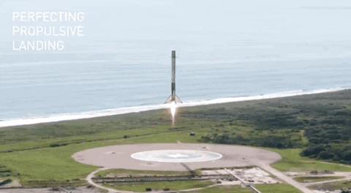









SpaceX Falcon 9 First Stage Landing Prediction
Dr. Mohsen Mesgar
13.02.2022

Slide 2



OUTLINE
Executive Summary
Introduction
Methodology
Results
Visualization – Charts
Dashboard
Discussion
Findings & Implications
Conclusion
Appendix

Slide 3

EXECUTIVE SUMMARY (Abstract)
The task is to predict if Falcon 9 first stage lands successfully.
What we do
Collect data from the wiki page of SpacX
Conduct EDA on the data to predict some trend
Train machine learning models (support vector machines (SVM), LogisticRegression, and Decsision Tree).
Findings
The sucess rate since 2013 kept increasing till 2020
Different orbits have different success rates.
DecisionTree achieves 90% accuracy and outperforms the other examined ML model.

Slide 4

INTRODUCTION
We aim at predicting if the Falcon 9 first stage lands successfully.
SpaceX advertises Falcon 9 rocket launches on its website with a cost of 62 million dollars; other providers cost upward of 165 million dollars each, much of the savings is because SpaceX can reuse the first stage. Therefore if we can determine if the first stage will land, we can determine the cost of a launch. This information can be used if an alternate company wants to bid against SpaceX for a rocket launch.

Slide 5

METHODOLOGY
Gathering the data including a class label to say if a landing is successful or not.
We do webscraping methods to collect such data from Wikipedia.
We deal with missing values of an attribute by replacing its NaN values with the mean of its values for other examples.
We explore the data using some Exploratory Data Analysis (EDA) methods to find some patterns in the data.
We study these patterns using data visualization methods
We conduct a feature engineering to understand what attribute in the data is distinctive between successful and unsuccessful landings.
We build different types of machine learning methods such as (decision trees, logistic regression, and SVM) to predict if a landing is successful or not.

Slide 6
Data collection-SpaceX API
Request and parse the SpaceX launch data using the GET request (source: SpaceX API)
Filter the Dataframe to only include Falcon 9 launches
Dealing with Missing Values
URL: https://github.com/MMesgar/tutorial-data-science/blob/main/capstone/1.jupyter-labs-spacex-data-collection-api.ipynb

Slide 7
Data collection-Web scraping
Request the Falcon9 Launch Wiki page from its URL using Python’s BeautifulSoup library
Extract all column/variable names from the HTML table header
Create a data frame by parsing the launch HTML tables
URL: https://github.com/MMesgar/tutorial-data-science/blob/main/capstone/2.jupyter-labs-webscraping.ipynb

Slide 8
Data wrangling methodology
Calculate the number of launches on each site
Calculate the number and occurrence of each orbit
Calculate the number and occurence of mission outcome per orbit type
Create a landing outcome label from Outcome column
URL: https://github.com/MMesgar/tutorial-data-science/blob/main/capstone/1.jupyter-labs-spacex-data-collection-api.ipynb

Slide 9
EDA with data visualization
Visualize the relationship between Flight Number and Launch Site
Visualize the relationship between Payload and Launch Site
Visualize the relationship between success rate of each orbit type
Visualize the relationship between FlightNumber and Orbit type
Visualize the relationship between Payload and Orbit type
Visualize the launch success yearly trend
Create dummy variables to categorical columns
Cast all numeric columns to float64
URL: https://github.com/MMesgar/tutorial-data-science/blob/main/capstone/5.jupyter-labs-eda-dataviz.ipynb
Notes:
: Summarized what charts were plotted and why used those charts. Also added the GitHub URL of the completed EDA with data visualization lab

Slide 10
EDA with SQL
Display the names of the unique launch sites in the space mission
Display 5 records where launch sites begin with the string 'CCA'
Display the total payload mass carried by boosters launched by NASA (CRS)
Display average payload mass carried by booster version F9 v1.1
List the date when the first successful landing outcome in ground pad was acheived.
List the names of the boosters which have success in drone ship and have payload mass greater than 4000 but less than 6000
List the total number of successful and failure mission outcomes
List the names of the booster_versions which have carried the maximum payload mass.
List the failed landing_outcomes in drone ship, their booster versions, and launch site names for in year 2015
Rank the count of landing outcomes (such as Failure (drone ship) or Success (ground pad)) between the date 2010-06-04 and 2017-03-20, in descending order
URL: https://github.com/MMesgar/tutorial-data-science/blob/main/capstone/4.jupyter-labs-eda-sql-coursera.ipynb
Notes:
Summarized performed SQL queries and added the GitHub URL of the completed EDA with SQL lab

Slide 11
Interactive visual analytics
Mark all launch sites on a map
Mark the success/failed launches for each site on the map
Calculate the distances between a launch site to its proximities
URL: https://github.com/MMesgar/tutorial-data-science/blob/main/capstone/5.jupyter-labs-eda-dataviz.ipynb
Notes:
Summarized the completed Folium map and Ploty Dash application. Also added the GitHub URLs of the completed Folium and Plotly Dash applications

Slide 12
Predictive analysis (classification)
Standardize the data
Use the function train_test_split to split the data X and Y into training and test data. Set the parameter test_size to 0.2 and random_state to 2.
Create a logistic regression object then create a GridSearchCV object
Create a support vector machine object then create a GridSearchCV object svm_cv with cv – 10
Create a decision tree classifier object then create a GridSearchCV object tree_cv with cv = 10
Create a k nearest neighbors object then create a GridSearchCV object knn_cv with cv = 10
URL: https://github.com/MMesgar/tutorial-data-science/blob/main/capstone/7.SpaceX_Machine%20Learning%20Prediction_Part_5.ipynb
Notes:
Presented how they built, evaluated, improved, and found the best classification model using key phrases and flow charts - Added the GitHub URL of the completed predictive analysis lab

Slide 13
RESULTS
We collected examples of landings represented with 16 different attributes and 1 class label that shows if a landing is successful or not
The following slides summarize the results.

Slide 14
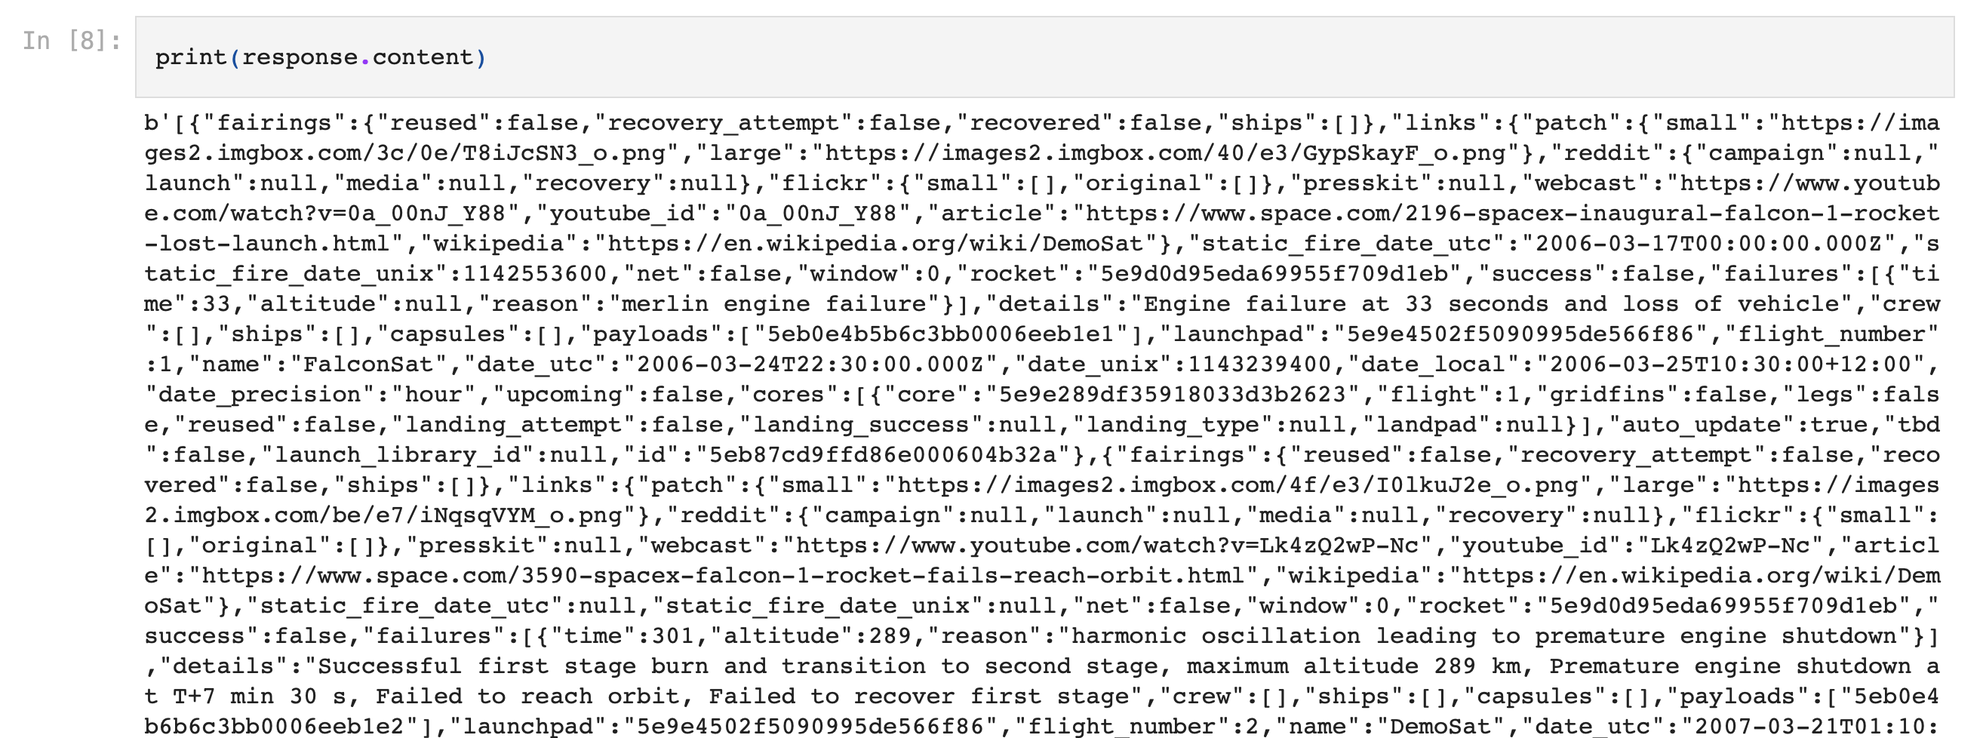
Results: Data collection-SpaceX API
Request and parse the SpaceX launch data using the GET request

Slide 15
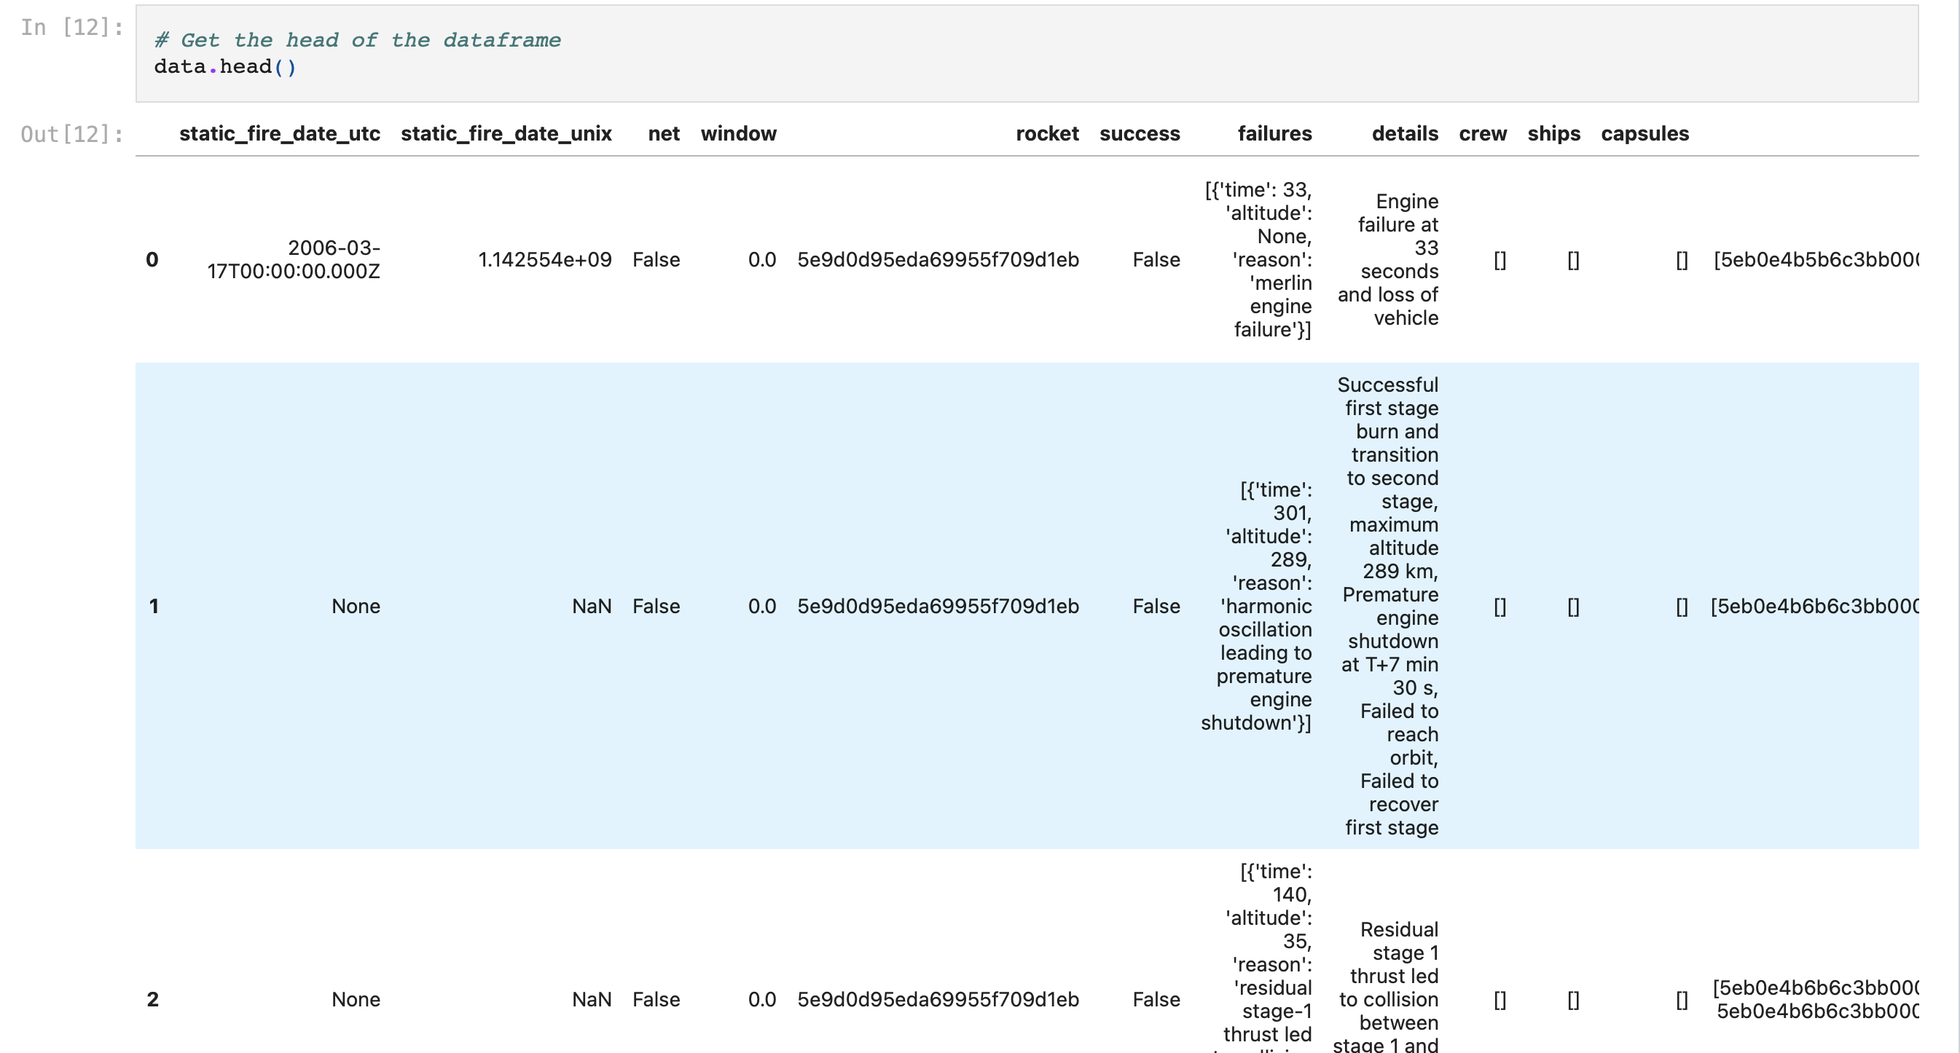
Results: Data collection-SpaceX API
Filter the dataframe to only include Falcon 9 launches

Slide 16
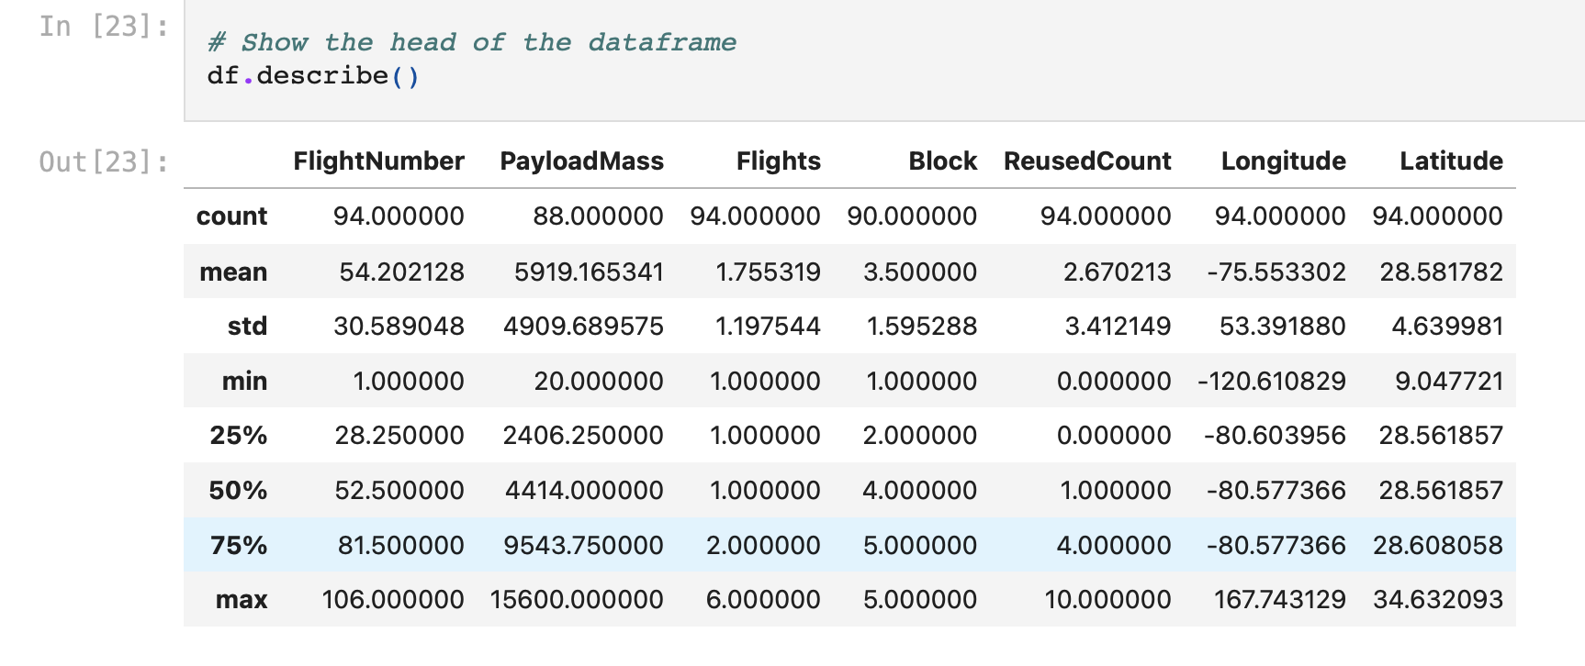
Results: Data collection-SpaceX API
A summary of data

Slide 17
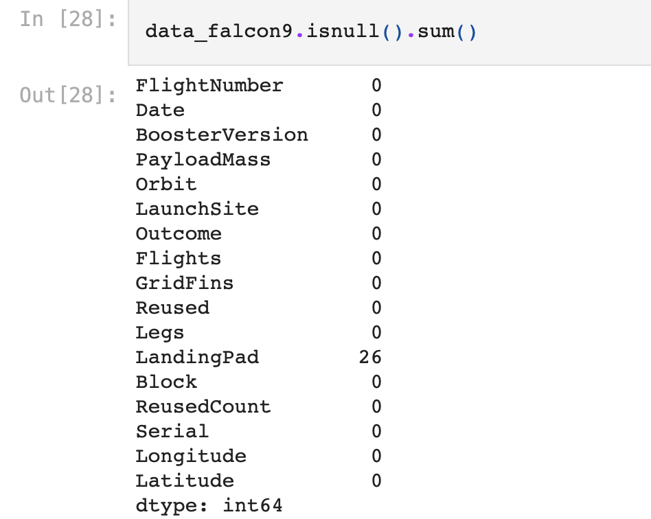
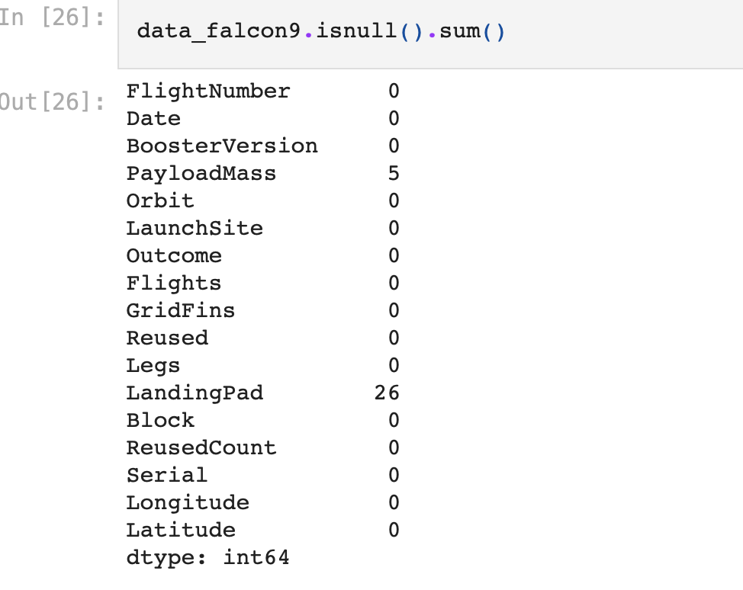
Results: Data collection-SpaceX API
Dealing with Missing Values

Slide 18
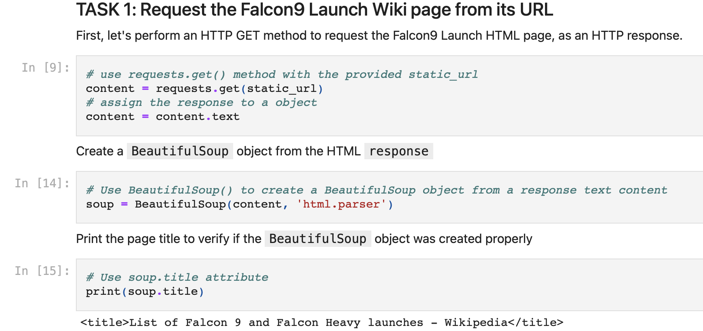
Results: Data collection-Web scraping

Slide 19
Results: Data collection-Web scraping

Slide 20
Results: EDA with data visualization

Slide 21
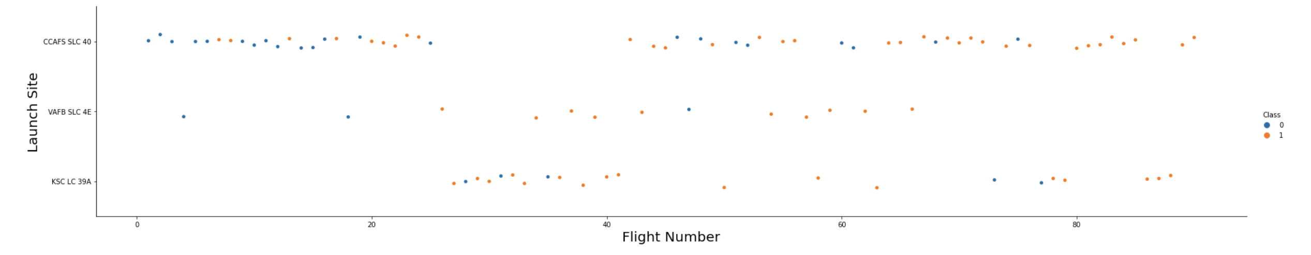
Results: Flight Number vs. Launch site scatter chart
For CCAFS SLC 40, the higher the payload, the better the success rate.
For KSC LC39A, the opposite seems to be correct.

Slide 22
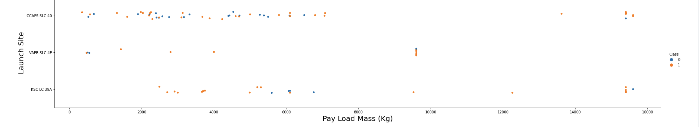
Results: Payload vs. Launch site scatter chart

Slide 23
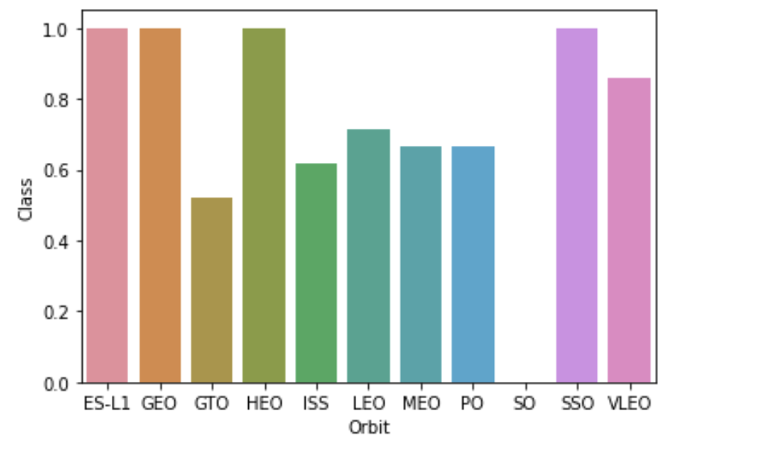
Results: Success rate vs. Orbit type bar chart
ESL1, GEO, HEO, SSO have not failed.

Slide 24
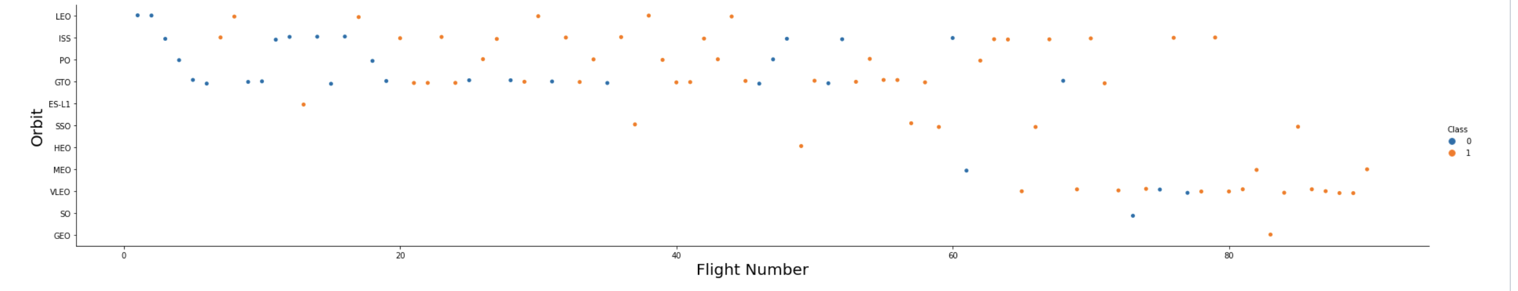
Results: Flight Number vs. Orbit type scatter chart

Slide 25
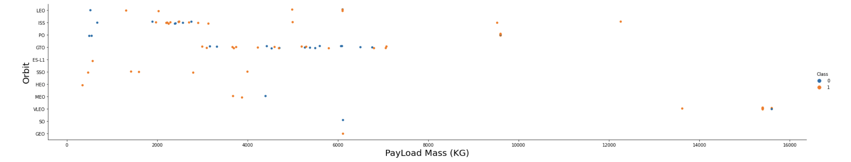
Results: Payload vs. Orbit type scatter chart

Slide 26
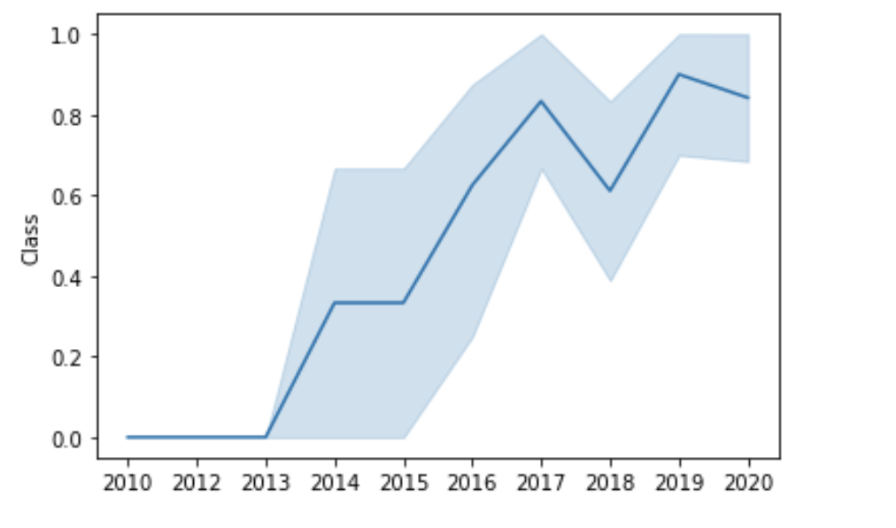
Results: Launch success yearly trend line

Slide 27
Results: EDA with SQL

Slide 28
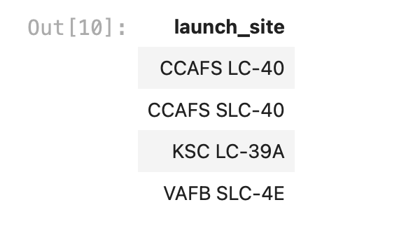
Results: All launch site names: Find the names of the unique sites

Slide 29
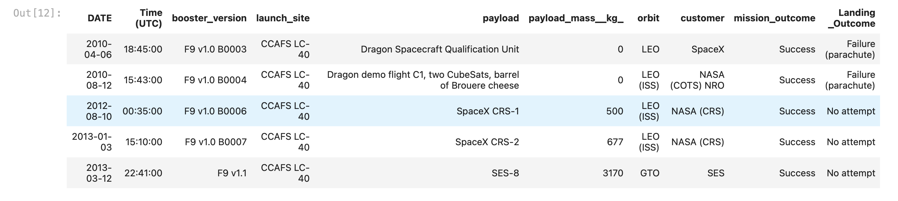
Results: Launch site names begin with `CCA`

Slide 30
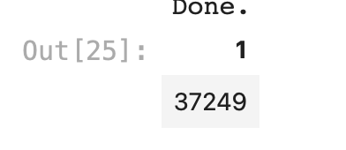
Results: Total payload mass: Calculate the total payload carried by booster from NASA

Slide 31
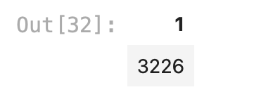
Results: Average payload mass by F9 v1.1

Slide 32

Results: First successful ground landing date

Slide 33
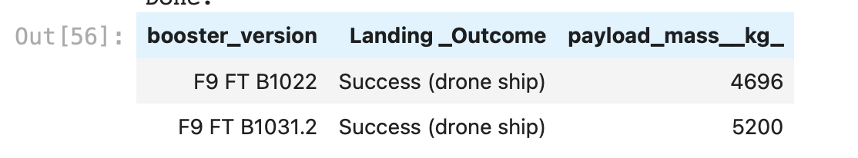
Results: Successful drone ship landing with payload between 4000 and 6000

Slide 34
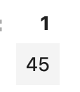
Results: Total number of successful and failure mission outcomes

Slide 35
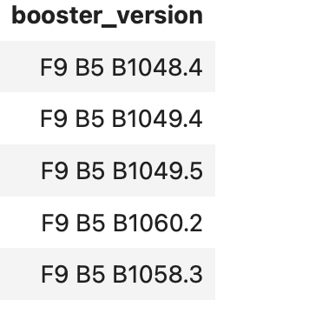
Results: Boosters carried maximum payload

Slide 36
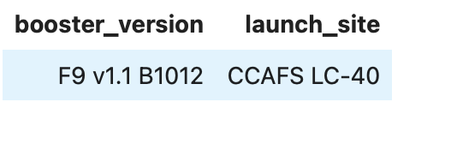
Results: 2015 launch records

Slide 37
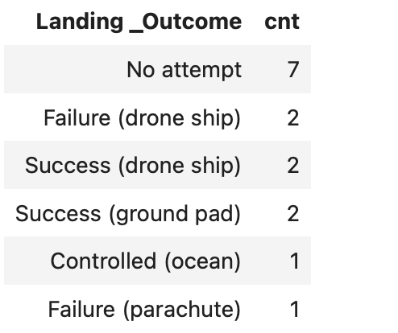
Results: Rank success count between 2010-06-04 and 2017-03-20

Slide 38
Results: Interactive visual analytics

Slide 39
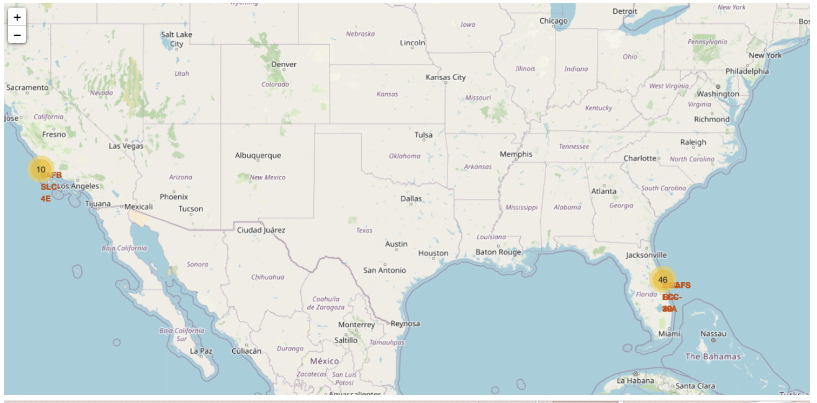
Results: Screenshot of all launch sites’ markers on a global map

Slide 40
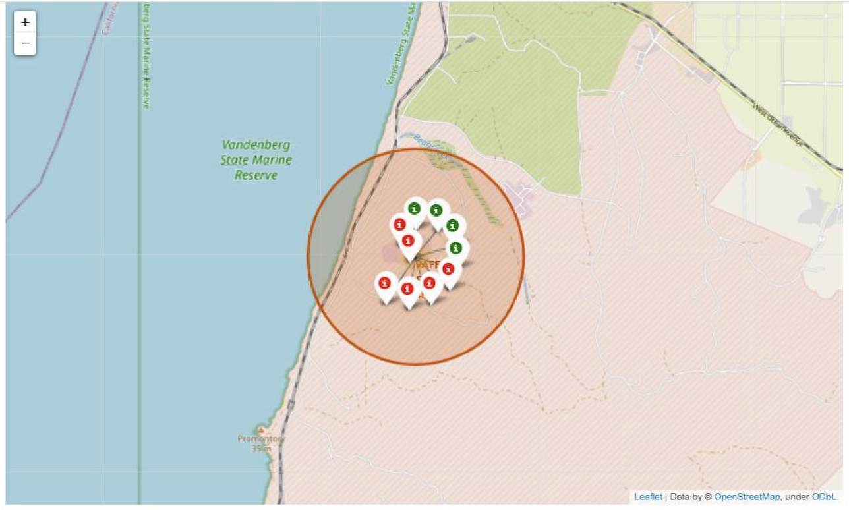
Results: Screenshot of all launch records per site on the map

Slide 41
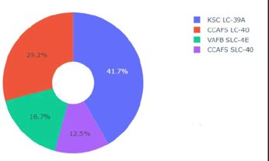
Results: Screenshot of launch success count for all sites, in a pie chart

Slide 42
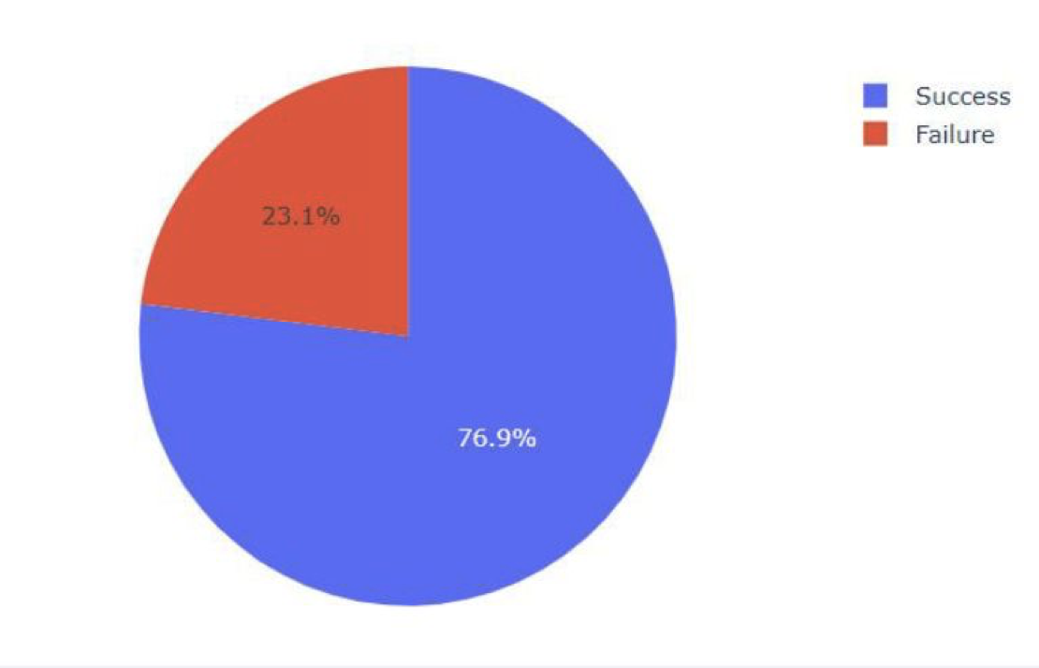
Results: Screenshot of the pie chart for the launch site with the highest launch success ratio

Slide 43
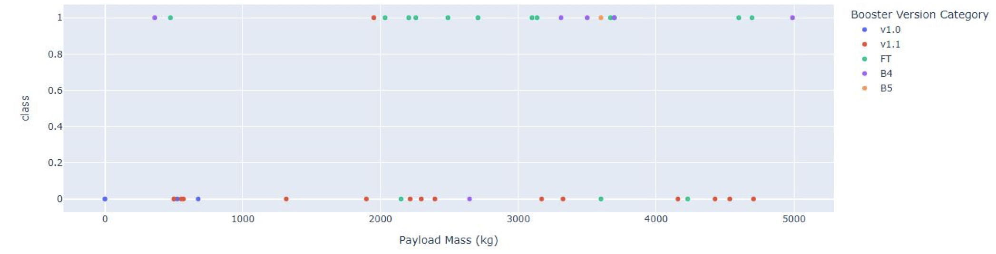
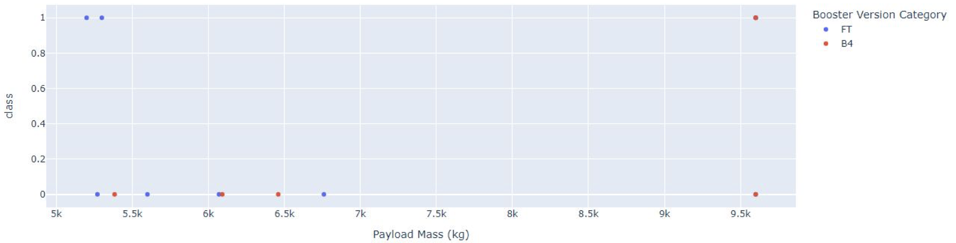
Results: Screenshot of Payload vs. Launch outcome scatter plot for all sites

Slide 44
Results: Predictive analysis (classification)

Slide 45
Classification. KNN vs logisticRegression vs SVM vs DecisionTree
Model | Accuracy (%)
LogisticRegression | 84.64
Support Vector Machines (SVM) | 84.82
KNN | 84.82
Decision Tree | 90.18

Slide 46
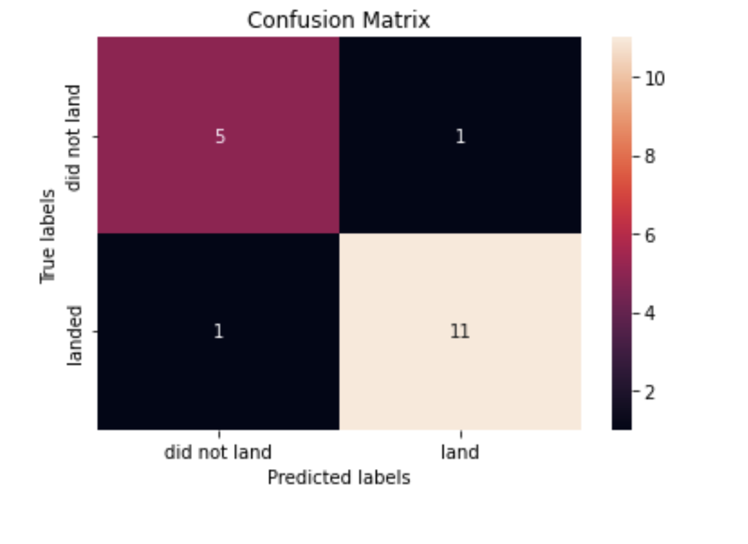
Displayed the confusion matrix of the best model

Slide 47

DISCUSSION
The DecisionTree model achieves the best accuracy compared with LogisticRegression and Support Vector Machines.
So if we use our DecsisionTree model, we can predict if a future landing can be successful with about 10% error rate.

Slide 48

CONCLUSION
Our goal was to predict if the Falcon 9 first stage lands successfully.
We collected data from SpaceX wiki page.
We then extracted several distinctive features.
We find out the decision tree is the best performing model for achieving our goal.

Slide 49

APPENDIX
The repository of this project is here:
https://github.com/MMesgar/tutorial-data-science/tree/main/capstone

